Slide 1

Introduction to Software Reliability Metrics
Software reliability is crucial for user satisfaction, business success, and even safety. It ensures the consistent and predictable operation of software systems.

Slide 2

Importance of Software Reliability
Reliable software enhances user trust, reduces development costs, and minimizes downtime. It also promotes a positive brand image and ensures business continuity.
1
User Satisfaction
2
Reduced Costs
Reliable software leads to positive user experiences, fostering loyalty and repeat business.
Preventing software failures reduces maintenance expenses and minimizes business disruption.
3
Enhanced Security
4
Improved Efficiency
Robust software is less susceptible to security vulnerabilities, protecting sensitive data and systems.
Reliable software enables smooth operations, boosting productivity and reducing wasted time.

Slide 3
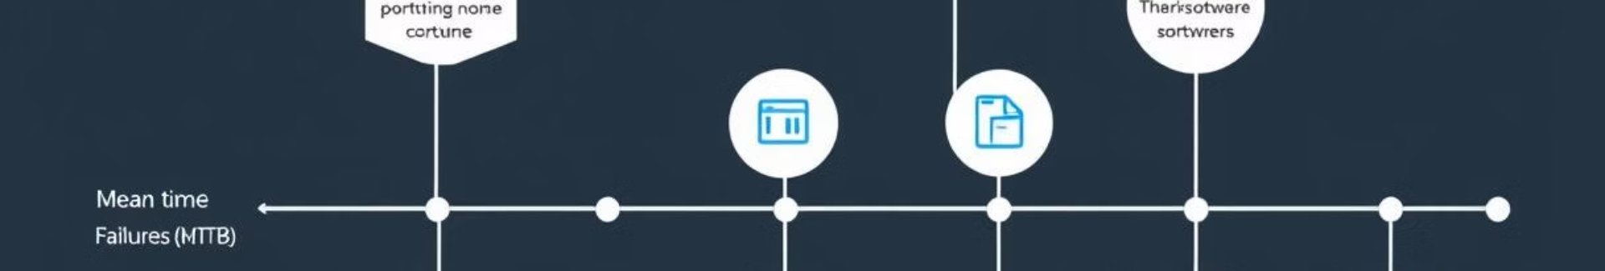
Mean Time Between Failures (MTBF)
MTBF measures the average time a system operates without failure. It's a key metric for evaluating the reliability of hardware and software systems.
1
2
3
4
Initial Deployment
First Failure
Second Failure
Continuing Monitoring
A new system is deployed and monitored for failures.
The system encounters its first failure, marking the start of the MTBF calculation.
The system experiences another failure, allowing for the calculation of the MTBF.
The system continues to be monitored for failures, updating the MTBF value over time.

Slide 4
Defect Density
Defect density measures the number of defects per unit of code. It helps identify areas with higher concentrations of bugs and potential vulnerabilities.
Code Size
Defect Count
Calculation
The total number of lines of code in the software system.
The number of bugs or defects discovered during testing and development.
Defect density is calculated by dividing the defect count by the code size.

Slide 5
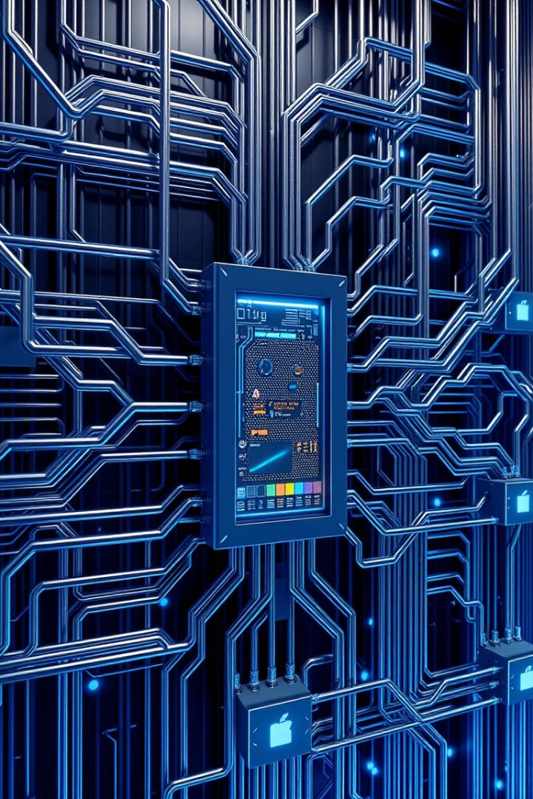



Fault Tolerance
Fault tolerance allows a system to continue operating despite failures in individual components. It ensures resilience and reduces downtime.
Redundant Components
Multiple identical components are deployed, allowing the system to function even if one fails.
Error Detection & Recovery
Mechanisms are in place to detect errors, isolate faulty components, and recover from failures.
System Monitoring
Continuous monitoring helps detect anomalies and triggers corrective actions to prevent cascading failures.

Slide 6
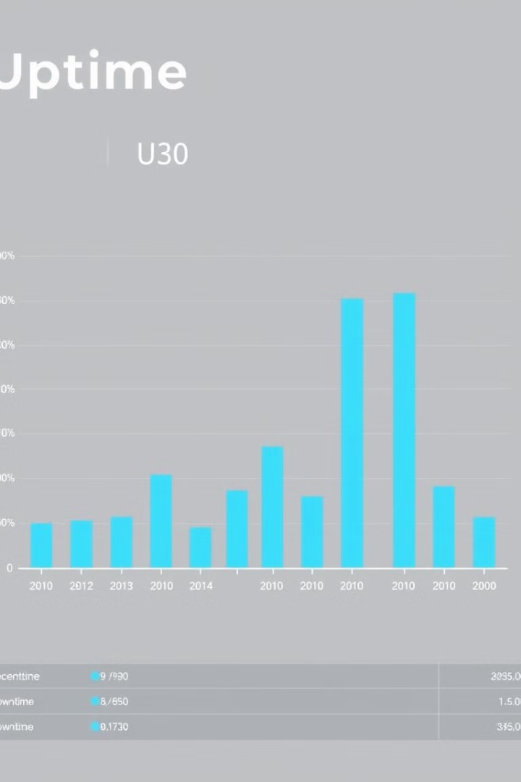
Availability
Availability refers to the percentage of time a system is operational and accessible to users. It's essential for applications with critical uptime requirements.
High Availability
99.999% or greater
Medium Availability
99.9% to 99.999%
Low Availability
Less than 99.9%

Slide 7
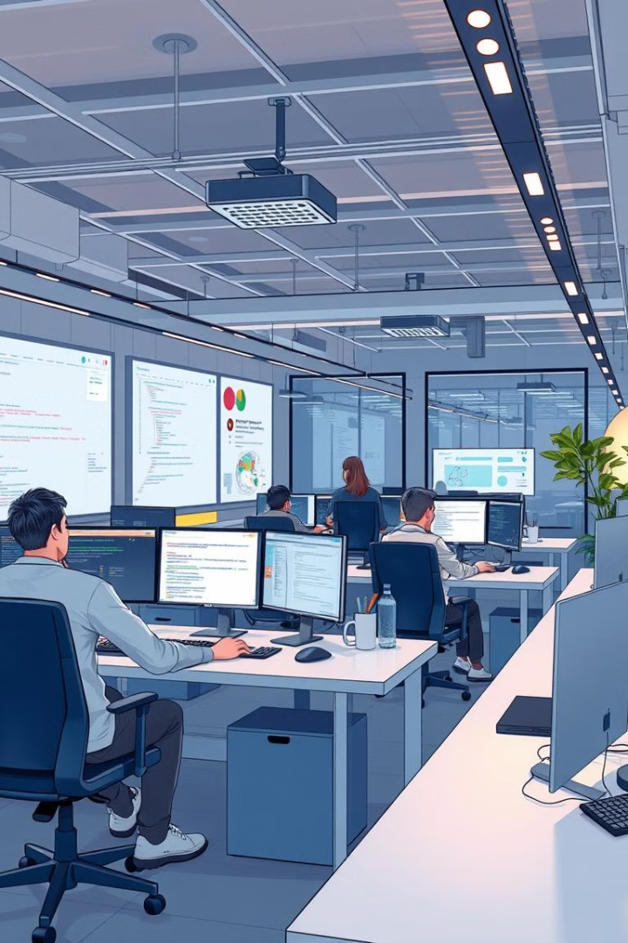




Maintainability
Maintainability refers to the ease with which software can be modified, fixed, and updated. It's crucial for long-term software lifecycle management.
Modular Design
Clear Documentation
Code is structured into independent modules, facilitating easier modifications and updates.
Comprehensive documentation provides clear instructions for understanding and maintaining the software.
Testable Code
Performance Monitoring
Code is designed to be easily tested, allowing for quick identification and resolution of issues.
Regular monitoring helps identify performance bottlenecks and proactively address them.

Slide 8
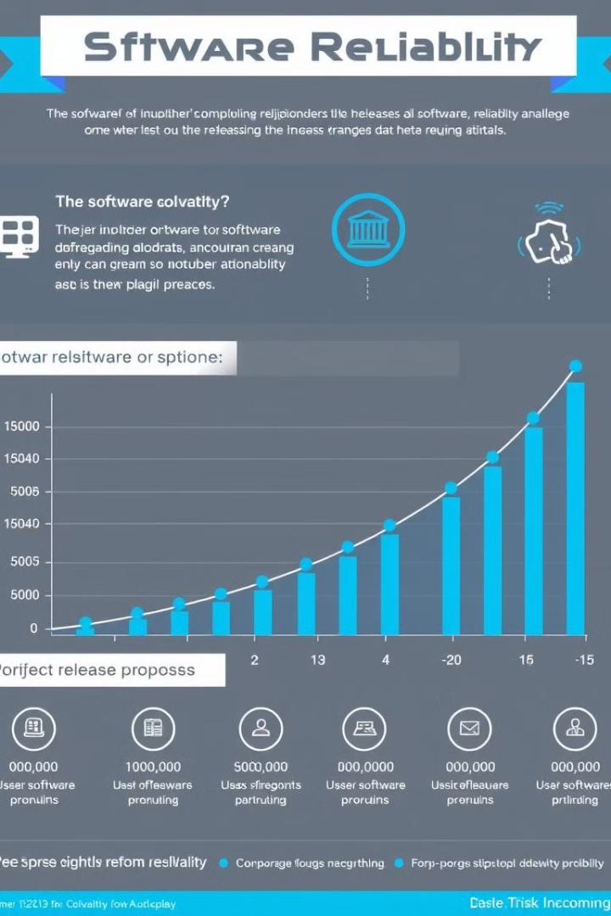
Reliability Growth Models
Reliability growth models predict the future reliability of software based on historical data. They help identify trends and estimate the time needed to achieve a desired level of reliability.
Musa Model
Jelinski-Moranda Model
A popular model based on the assumption that defects are removed at a decreasing rate over time.
A simple model that assumes a constant defect removal rate, useful for early stages of testing.
Goel-Okumoto Model
A more complex model that accounts for varying defect removal rates, suitable for mature software systems.

Slide 9
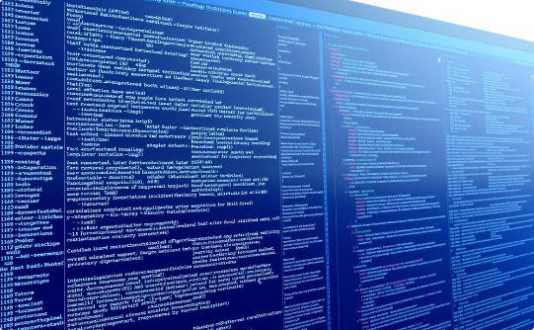


Measuring and Analyzing Software Reliability
Software reliability can be measured through various techniques, including testing, monitoring, and data analysis. These methods provide insights into system behavior and identify areas for improvement.
Code Reviews
Automated Testing
Performance Monitoring
Manual inspection of code for defects and potential vulnerabilities.
Using tools to run automated tests, detecting defects early in the development cycle.
Tracking system performance indicators to identify bottlenecks and areas for optimization.

Slide 10

Conclusion and Key Takeaways
Software reliability is not just a technical concern, but a strategic one. By prioritizing reliability, organizations can build trust, reduce costs, and achieve sustainable success.
1
Prioritize Quality
Invest in comprehensive testing and quality assurance practices.
2
Embrace Continuous Improvement
Continuously monitor and analyze reliability data to identify areas for improvement.
3
Foster Collaboration
Encourage collaboration between developers, testers, and users to identify and resolve issues efficiently.

